Slide 1
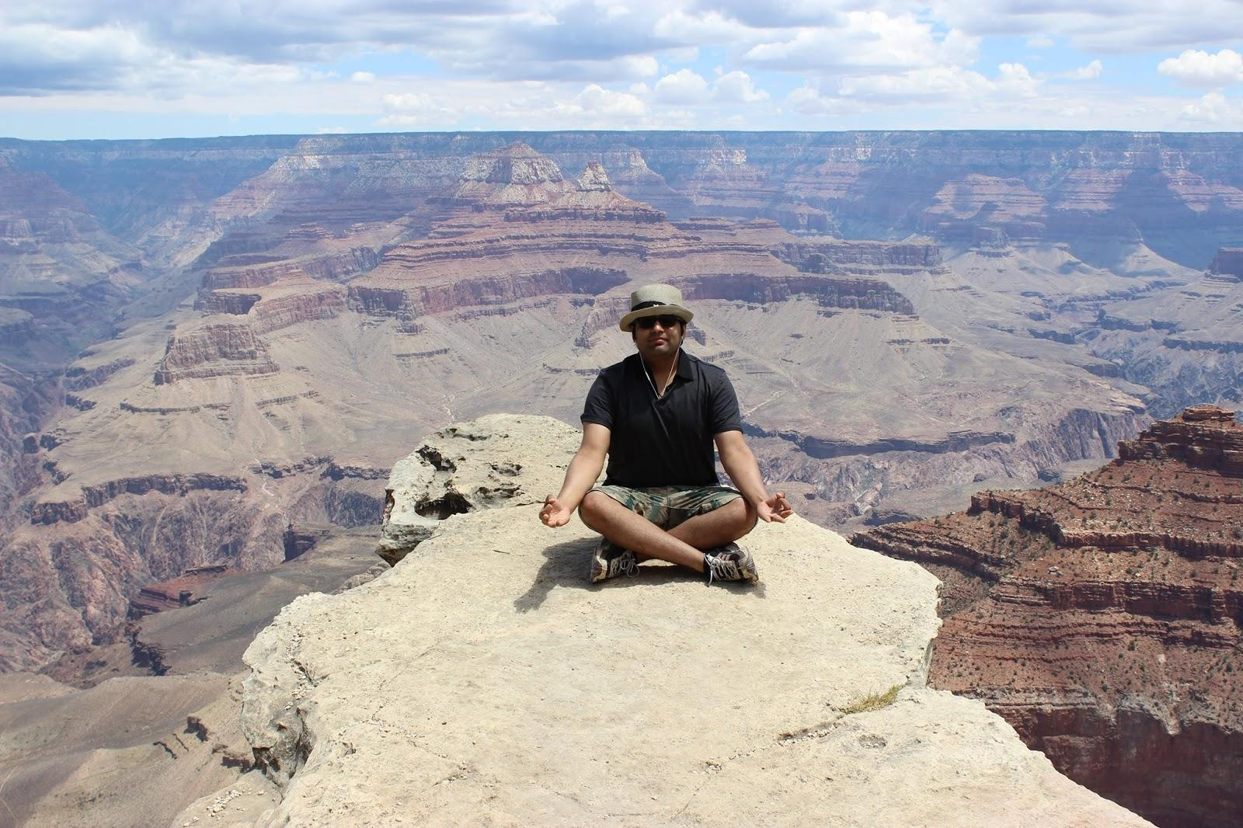
I, Me & Myself
Sameer Sawla ITWS-Grad CS-UGrad

Slide 2
if(HW-Xperience)
{
EXIT;
}
else if(SW-Xperience)
{
NEXT;
}

Slide 3
SW-Xperience
-- First copied program in 3rd grade in
Pascal.
-- First original program in 4th grade in
BASIC language.

Slide 4
SW-Xperience contd.
-- Exploited Graphics.h lib of C++ @ Blue Prints
-- Undergrads :
-- Online Hotel Reservation. Access as DB :P
-- Data Mining - no project management
strategy

Slide 5


Professional-Xperience - I
Software / Senior Software CMS Engineer (2 yrs) at Content
India’s IInd largest IT firm. Mgmt
System
JAVA, JSP, JS, CSS, XML,
PeopleSoft, Oracle
SVN, JUnit

Slide 6
RPI
-- Online Library Reservation System - HCI
-- DocuBuilder-v0.1 @ Data Communique`
-- SmartWatch #Android #Soccer

Slide 7

Professional-Xperience - II.1
-- i18n & l10n :
An API : Wrapper to an API
-- Counter Strike, League of Legends :P

Slide 8
Professional-Xperience II.2
-- Introduced to motion / gesture sensing
electronics. -- LEAP motion.
-- Application parser. (Regular Expression)
Full JavaScript Stack. AngularJS, NodeJS, POJS, EJS, RequireJS, D3js, Promises, HTML, CSS, JAVA, Python, JasmineJS, GitHub, Yeoman, JIRA

Slide 9

Lets get personal
Personal Story Career Goal
4-5 yrs work-ex
GMAT ----- MBA
Executive Position
.. RELAX..

Slide 10
Good s/w Engineer :
Team-Work
Say No To Procrastination
------------GOOGLE-------------
Expectations from the Class :
Real Software development knowledge focusing on much needed wisdom on the methodology driving it.

Slide 11
Hobbies :
Guitar.
Piano.
Gaming.

Slide 12
THANK YOU !!!!

